Slide 1


Grupo 04:
Jorge Kessler Martín
Guillermo López García
Eduardo Ariño Pelegrín
Jorge Cordobés Delgado
George Alexandru Stan

Slide 2


About MadCulturalEvents
Application based on the following datasets:
Actividades Culturales y de Ocio Municipal en los próximos 100 días
Centros Culturales Municipales
Museos de la ciudad de Madrid
Documented with the meaning of each field.
Analysis of datasets licensed under CC BY-SA 4.0 International

Slide 3

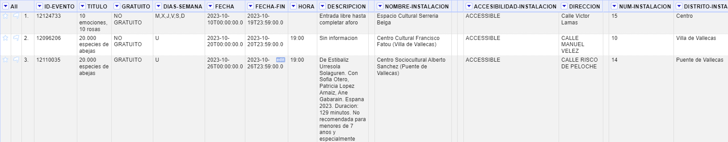

Data analysis and cleaning
Cleaning and organizing data
JSON of the changes made.
Reconciliation with Wikidata

Slide 4
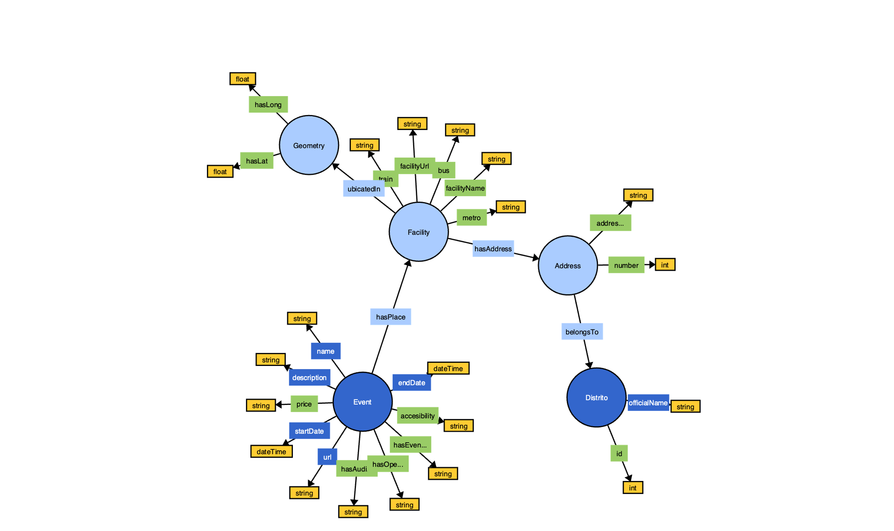
Ontology
http://www.madculturalevents.es/group04/ontology/madculturalevents#

Slide 5
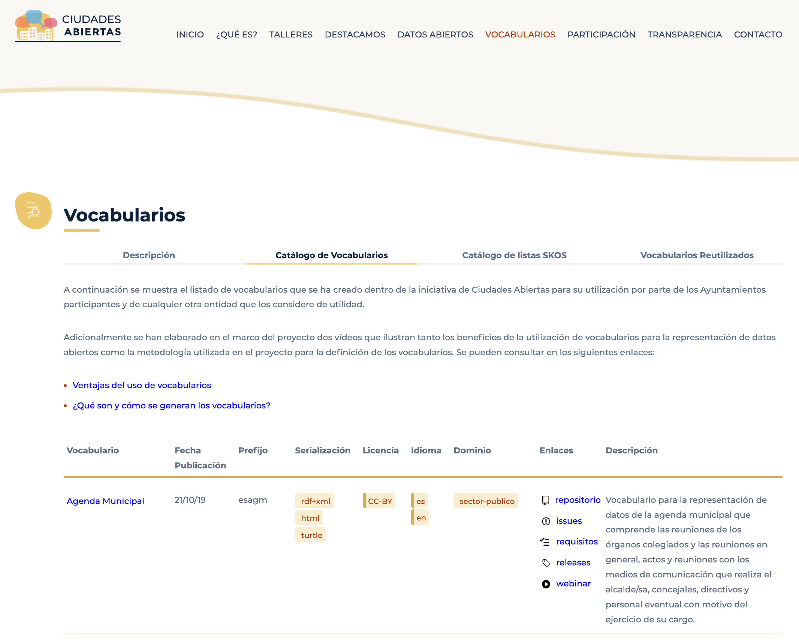
Vocabulary

Slide 6


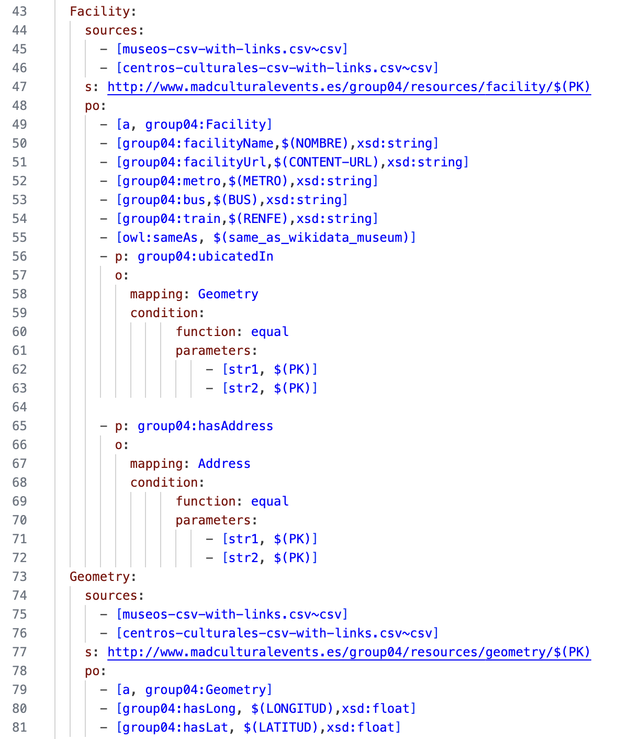
Mapping
RML file with mappings
YML file with the mapping rules
RDF file with NTriples in Turtle syntax

Slide 7
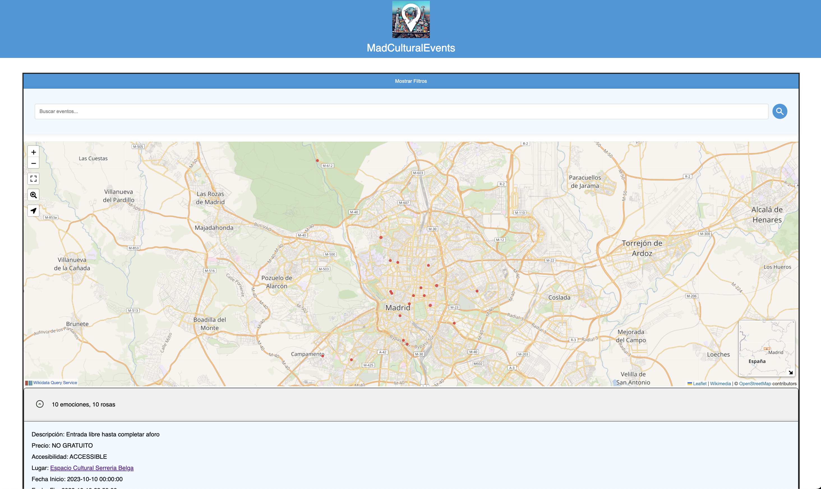
DEMO

Slide 8
Thank for your attention.
Questions?

